Slide 1

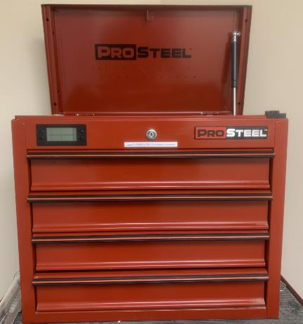
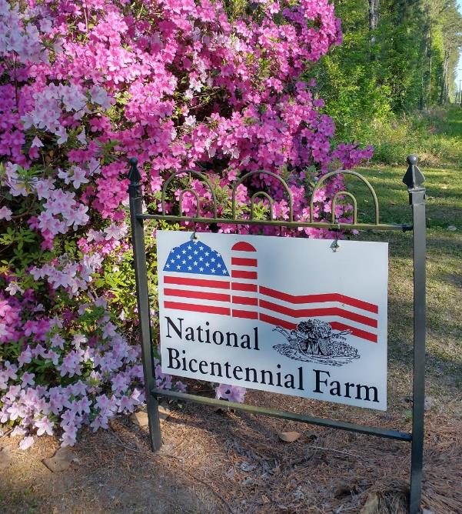
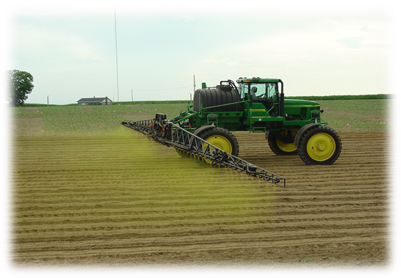
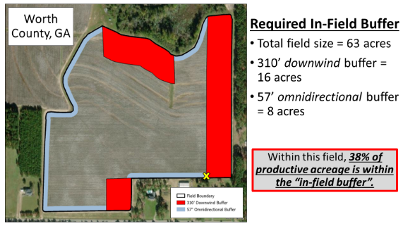
Weed Management for Wheat 2024/2025
Stanley Culpepper
University of Georgia
Tifton, Georgia
Pest Mgmt Toolbox is in Trouble!
1772

Slide 2
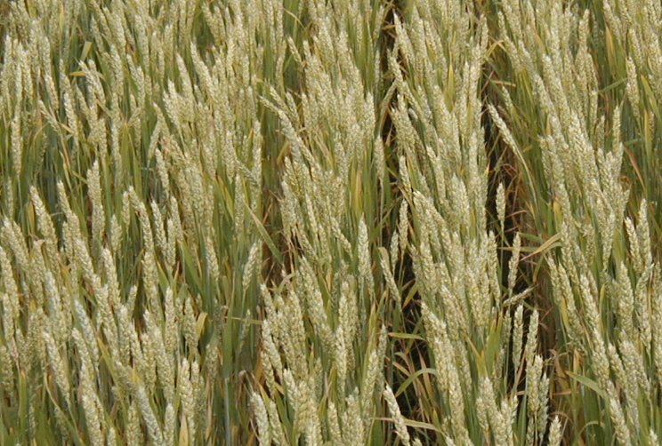
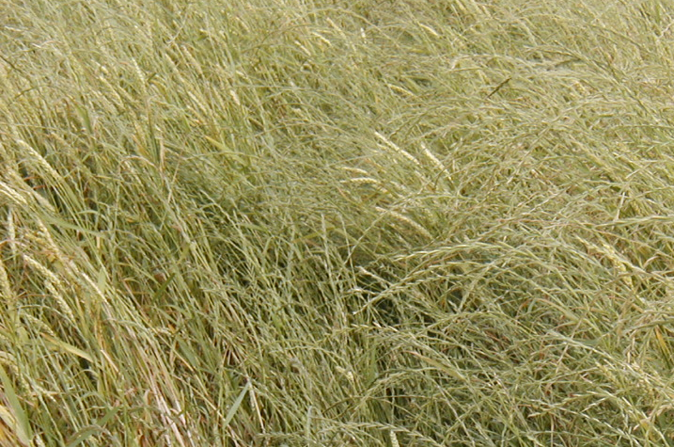
Ryegrass is Threating Production
Ryegrass, ryegrass, ryegrass
Resistance is spreading fast
No new herbicides
Rotation is part of the solution
Ryegrass must not be emerged when planting!
Can you deep turn?

Slide 3
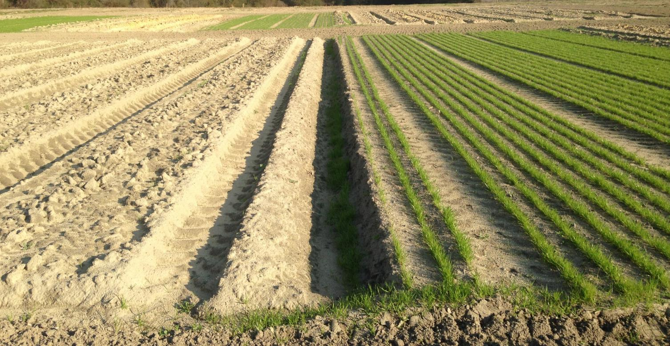
Weed Management for Wheat 2024/2025
Seed only emerges close to soil surface
Life of seed similar to pigweed (shortish)
Ryegrass planted 0.5” followed by deep turning.
Ryegrass planted 0.5” inch without tillage.

Slide 4
Preplant Options – No Plants At Planting
1. Tillage
2. Roundup (full+ rate; best single option)
3. Gramoxone
4. Harmony Extra TS (broadleaves)
5. Quelex (broadleaves)
6. Select 30 d plant back
7. 2,4-D: 24 d plant back
8. Valor: 30 d plant back

Slide 5
Annual Ryegrass Herbicide Options
Critical To Understand:
A systems approach similar to those used in agronomic crops is needed:
no ryegrass at planting,
early herbicide application focusing on residual control,
3) AND a POST is needed

Slide 6
Annual Ryegrass Herbicide Options
Critical To Understand: Similar to agronomic crops a systems approach of no ryegrass at planting, early herbicide, AND a POST is needed
Earlyish: Anthem Flex, Axiom, Fierce, Zidua, Prowl
POST (usually ~ Christmas): Axial Bold, Osprey, Powerflex

Slide 7
Annual Ryegrass Herbicide Options
Critical To Understand: Similar to agronomic crops a systems approach of no ryegrass at planting, early herbicide, AND a POST is needed
Earlyish: Anthem Flex, Axiom, Fierce, Zidua, Prowl
POST (usually ~ Christmas): Axial Bold, Osprey, Powerflex
ALSO CRITICAL: DO NOT APPLY THE SAME CHEMISTRY IN THE SAME FIELD EVEN 2 YEARS IN A ROW

Slide 8
Example Program for Ryegrass
Roundup or tillage if emerged just before planting
Zidua or Fierce after planting (follow restrictions)
Axial Bold or PowerFlex/Osprey

Slide 9
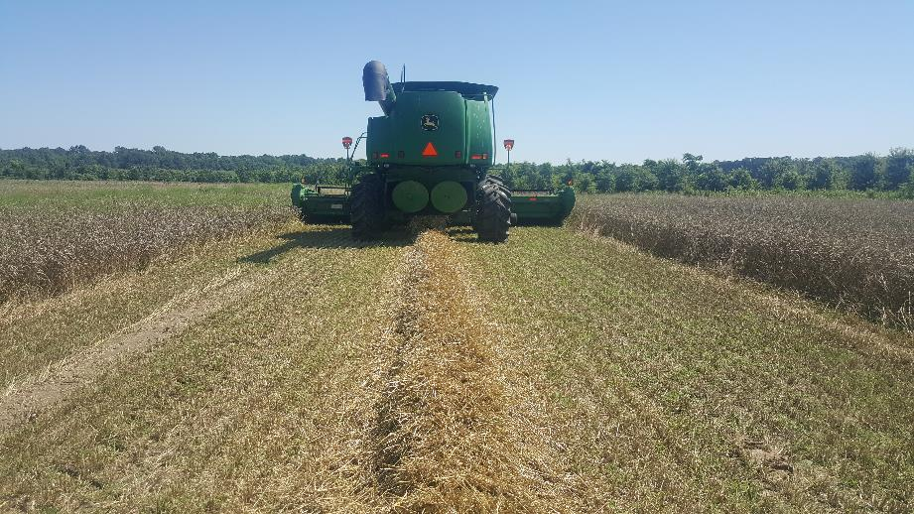
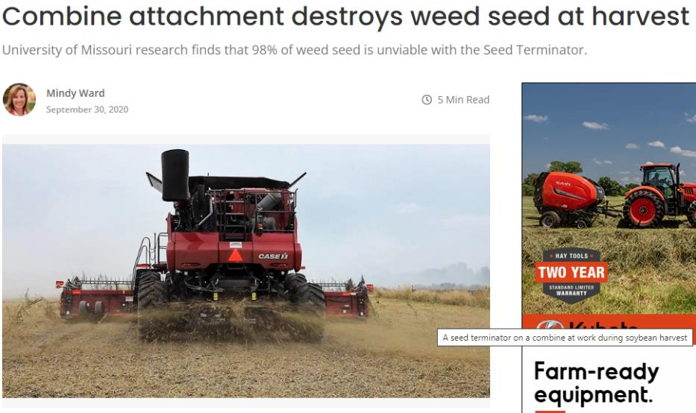
Some Growers in GA May Have to Get Creative
Chaff Lining
“The concentration of the chaff material places weed seeds in an environment unsuitable for germination and emergence.”
“Seed impact mills that utilize metal parts at high velocity to crack the seeds as they move through the mill, thereby greatly reducing their viability.”
Very good but requires lots of power and expensive!
Photo and text credit: Lauren Lazaro LSU/Blue River

Slide 10
In-Crop Broadleaf Herbicides
2,4-D
Harmony Extra
MCPA
Osprey
PowerFlex
Quelex

Slide 11
In-Crop Broadleaf Herbicides
2,4-D
Harmony Extra
MCPA
Osprey
PowerFlex
Quelex
1) MCPA + Harmony or Quelex
2) 2,4-D + Harmony or Quelex
3) Harmony or Quelex
fb
MCPA or 2,4-D

Slide 12
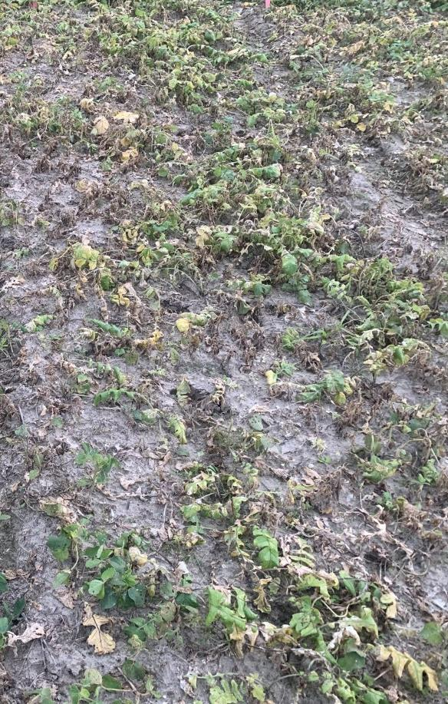
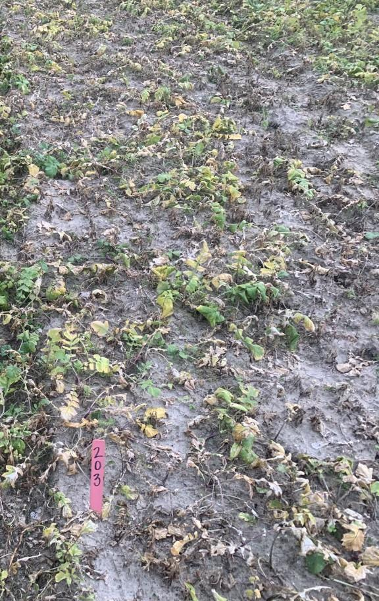
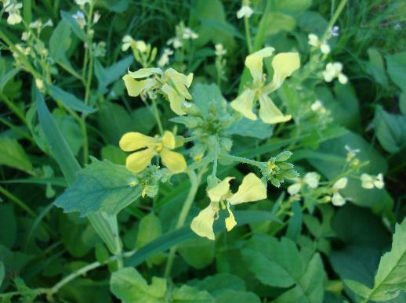
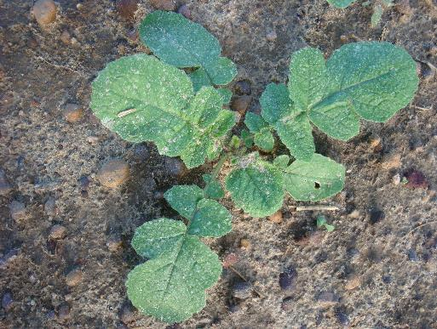
Wild Radish is # 1 Statewide
Harmony Extra TS + MCPA
Quelex + MCPA

Slide 13
What about other weeds……like Henbit
< 18 plants/m²: generally, no impact on yield
82 plants/m²: reduced yield up to 48%
Competition greater in winter months
Easily shaded out when blooming
If weeds are managed for the first 30 to 50 days, there will be no reduction in yield.
Hannah Wright 2022 Lit Review

Slide 14
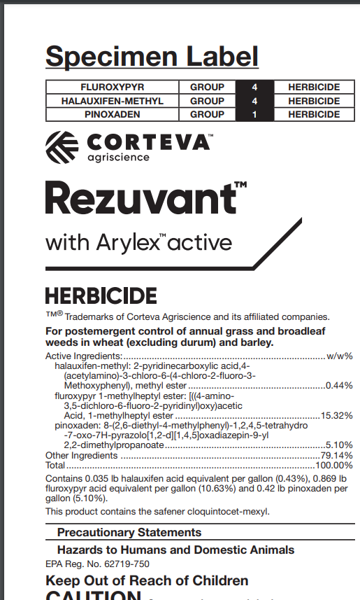
Anything New?
Three active ingredients
Similar to Axial + Quelex
We will begin our research this winter
In theory, not smart to mix a broadleaf herbicide with a ryegrass herbicide but let’s see

Slide 15
Take Home
For ryegrass, has to be more than just herbicides
Herbicide program for ryegrass: none at planting, residual early, and timely topical application.
For broadleaves, MCPA + Harmony or Quelex very effective across the state.
Notes:
Summary!

